Slide 1

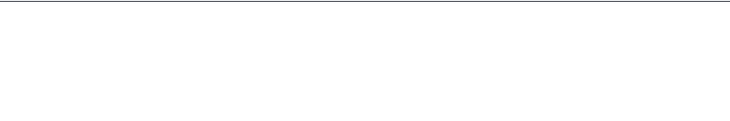
PROJECT REPORT PRESENTATION
Hate Speech Detection Using Machine Learning
Prepared by: Rohed Deb Ove & Tamjidul Hasan

Slide 2


The Problem
Information Overload
The exponential growth of Web 2.0 has made manual moderation of hate speech computationally infeasible due to the sheer volume of data.
Core Challenges
•
Linguistic Ambiguity: Sarcasm, slang, and context make detection difficult.
•
Data Imbalance: Hate speech is often the minority class (16%), biasing models towards "Not Hate".

Slide 3






Dataset & Methodology
The Source
Imbalance
Preprocessing
A large-scale dataset of approximately 842,000 comments collected from Wikipedia Talk pages, offering a diverse range of conversational text.
The data reflects real-world skew: 84.1% Not Hate vs. 15.9% Hate Speech. This 5.3:1 ratio requires careful handling during training.
Rigorous cleaning (URL removal, lowercasing) followed by TF-IDF Vectorization with Bigrams to capture contextual nuances.

Slide 4
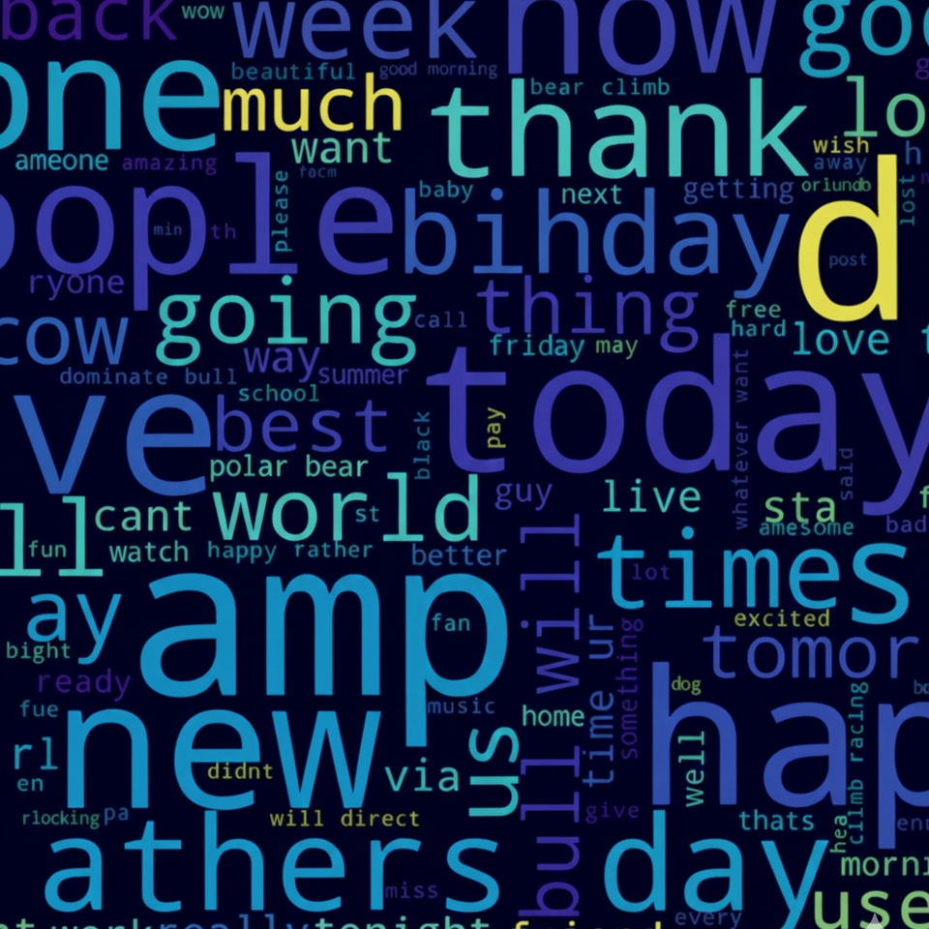
Word Visualization
Distinct Vocabularies
Not Hate: Dominated by Wikipedia-specific administrative terms like "article," "page," "edit," and "consensus."
Hate Speech: Characterized by explicit insults, racial slurs, and aggressive terms.
This clear lexical distinction suggests TF-IDF will be an effective feature extraction method.

Slide 5




Machine Learning Models
Multinomial Naive Bayes
Logistic Regression
Linear SVM
A probabilistic linear classifier. It offers a balance between speed and accuracy but struggled slightly with the high class imbalance.
The Winner. Creates an optimal hyperplane with maximum margin. Best suited for high-dimensional sparse data like text.
Used as a baseline. It is extremely fast but assumes feature independence, leading to lower recall for complex hate speech.

Slide 6
Model 1: Multinomial Naive Bayes
Class | Precision | Recall | F1-Score | Support
0 (Not Hate) | 0.92 | 0.96 | 0.94 | 141,728
1 (Hate) | 0.71 | 0.57 | 0.63 | 26,739
Accuracy | 0.89
Insight: High precision but very poor Recall (0.57) for the Hate class. It missed 43% of toxic comments.

Slide 7
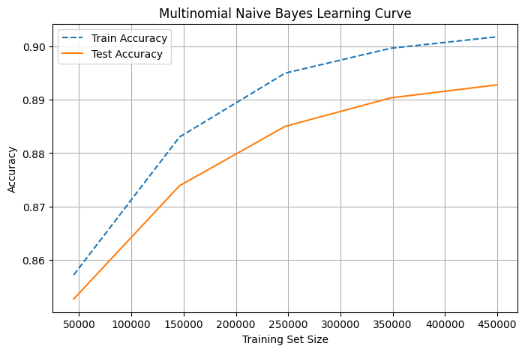

Learning Curve
Training Analysis
•
Extremely fast convergence due to probabilistic nature.
•
Shows a gap between training and validation accuracy.
•
Indicates potential bias/underfitting for the complex minority class.

Slide 8
Model 2: Logistic Regression
Class | Precision | Recall | F1-Score | Support
0 (Not Hate) | 0.92 | 0.97 | 0.95 | 141,728
1 (Hate) | 0.81 | 0.57 | 0.67 | 26,739
Accuracy | 0.90
Insight: Precision improved significantly to 0.81, but Recall remained low (0.57). It still misses too much toxicity.

Slide 9
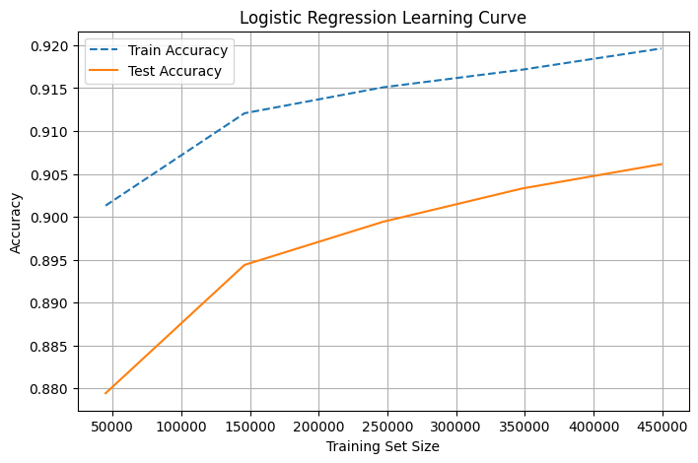
Learning Curve
Training Analysis
•
Smoother convergence compared to Naive Bayes.
•
Required more iterations (2000) to reach optimal weights.
•
Shows improved generalization but limited by the linear decision boundary on imbalanced data.

Slide 10
Model 3: Linear SVM (Best Model)
Class | Precision | Recall | F1-Score | Support
0 (Not Hate) | 0.95 | 0.97 | 0.96 | 141,728
1 (Hate) | 0.81 | 0.71 | 0.75 | 26,739
Accuracy | 0.93
Insight: The clear winner. Recall jumped to 0.71, detecting ~18,800 toxic comments compared to ~15,000 for others.

Slide 11
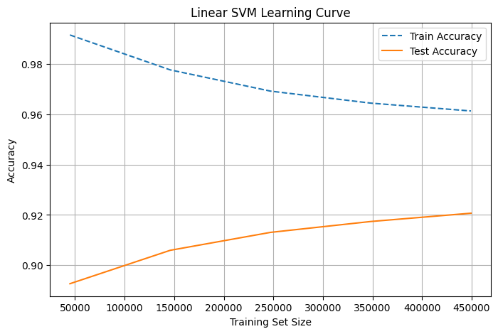
Learning Curve
Training Analysis
•
Best generalization gap among all models.
•
Robust against overfitting despite the large feature space.
•
Maximizing the margin allowed it to better handle the high-dimensional sparse data.

Slide 12
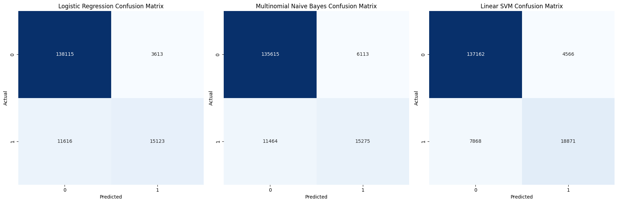
Confusion Matrix Analysis
Logistic Regression: Missed 11,616 toxic comments.
Linear SVM: Reduced misses to 7,868.
SVM provides a safer environment by catching 3,600+ more toxic instances than the others.
False Negatives (The Risk)

Slide 13
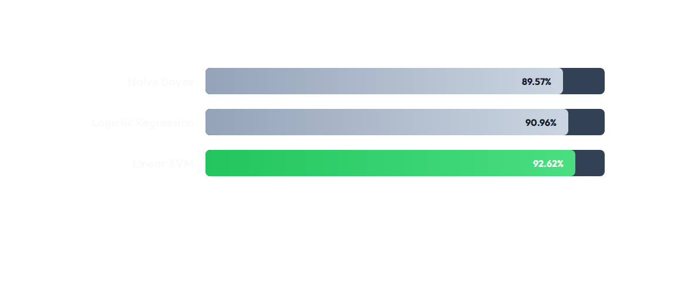
Comparative Analysis: Accuracy
While all models have high accuracy, SVM leads with 92.62%.

Slide 14
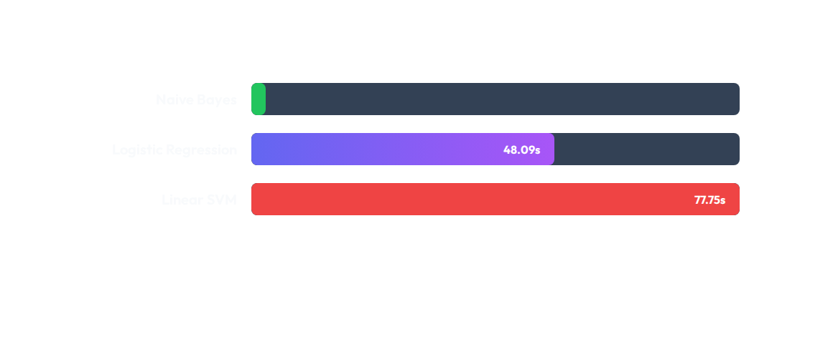
Computational Efficiency (Training Time)
Trade-off: SVM is ~130x slower than Naive Bayes, but 77 seconds is negligible for offline training given the performance boost.

Slide 15
Prediction on External Text
Input Text | Naive Bayes | Logistic Regression | Linear SVM
“We are worthless" | Hate | Hate | Hate
"I love this country" | Not Hate | Not Hate | Not Hate
"You are stupid idiot" | Hate | Hate | Hate
"Have a great day" | Not Hate | Not Hate | Not Hate
All models successfully distinguished between sentiment and didn't just flag "negative" words, proving semantic understanding.

Slide 16
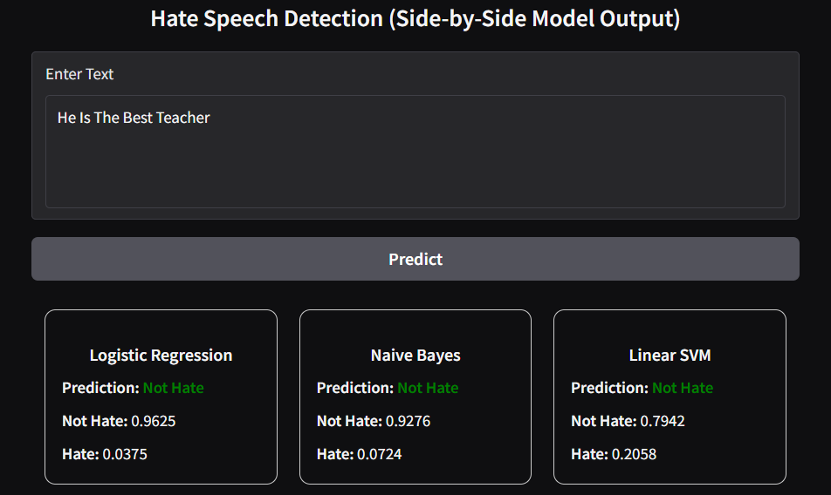
Real-Time Deployment
Gradio Web Interface
We deployed the models using Gradio to simulate a real-world moderation dashboard.
•
Allows side-by-side comparison.
•
Visualizes confidence scores.
•
Enables human-in-the-loop verification for edge cases.

Slide 17


Conclusion & Future Work
Conclusion
Future Work
The Linear SVM proved to be the most robust model, offering the best balance between precision and recall (Accuracy: 92.62%).
Deep Learning: Implement BERT for better context understanding.
Data Augmentation: Use SMOTE to fix class imbalance.
We successfully deployed the model using a Gradio web interface, enabling real-time side-by-side comparison of model predictions.
Multiclass: Detect specific types (Racism vs. Sexism).

Slide 18
Thank you for your attention.

